Slide 1
The Abbey Theatre Digital Archive: a large-scale, high-impact digital scholarship project
John Cox, University Librarian,
National University of Ireland Galway

Slide 2
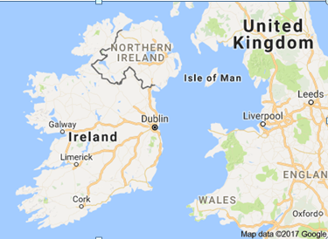
National University of Ireland Galway
Founded 1845
18,000 students, 2,600 staff
Top 250 ranking
Most disciplines, including:
Humanities/Social Sciences
Business and Law
Engineering
Medicine
Science

Slide 3
Outline
Significance and story of the digitisation project
Genesis of the Abbey Theatre-NUI Galway partnership
Scope and challenges
Impact on NUI Galway Library and Archives
Value for NUI Galway and scholarship

Slide 4
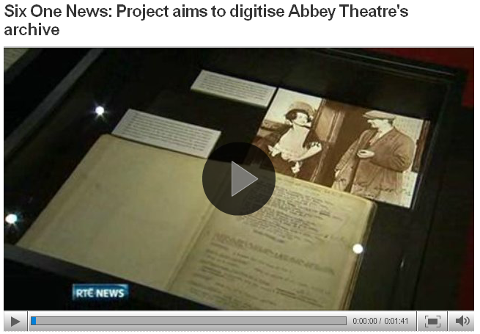
A National Story

Slide 5
Genesis
Partnership opportunity
NUI Galway:
research and teaching strengths in theatre and drama
other partnerships: Druid Theatre, Galway Arts Festival
substantial theatre archive holdings
Abbey Theatre:
extensive archive
limited cataloguing and access
long-term preservation

Slide 6
Project Scope
Digitise, catalogue and publish the archive online
Mix of paper, audio and video
1 million pages, 500 hours of video, 2500 hours of audio
Complete the retrospective digitisation in three years
Publish annual additions until 2037

Slide 7
Some Challenges
Prompt start, September 2012
Scale and range of material types, formats, equipment
Some fragile material
Some categories subject to 30-year rule or copyright restrictions
Editorial function for sensitive material
File storage: 30 terabytes in cloud
Library/Contractor/Academic/Institutional partnership

Slide 8
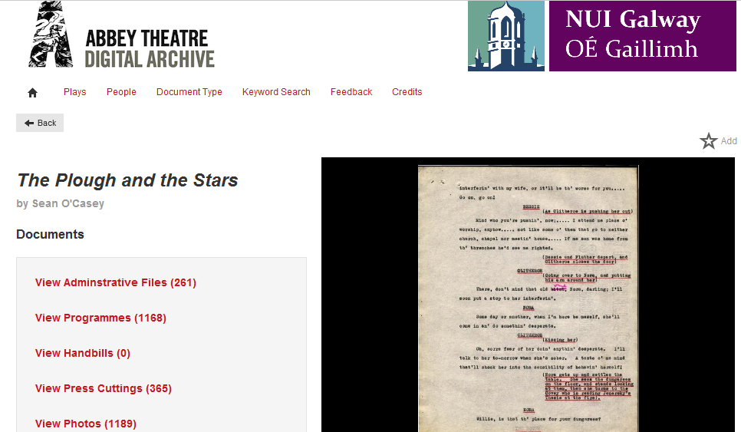
Fast Forward: completed on time and on budget, August 2015

Slide 9
Impact on Library
Operating at scale
New expectations, partnerships
Digital scholarship strategy
Formation of new team
Governance and accountability
Projects and partnerships
Challenges

Slide 10
Operating at Scale
Pre-2012: Relatively small scale, often ad hoc, digital projects
Multiple systems, platforms, workflows
Abbey programmes: 50,000 + pages

Slide 11
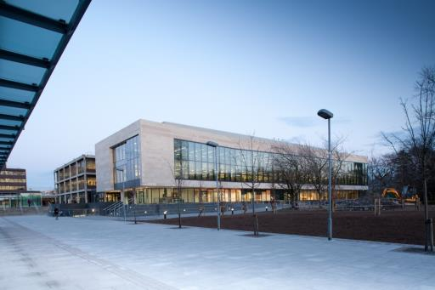
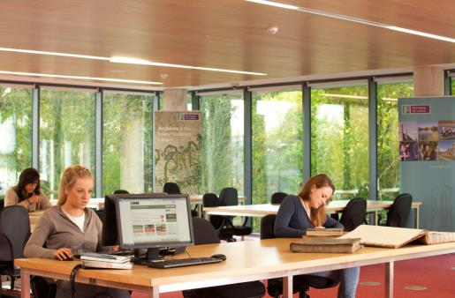
New Building, New Neighbours, New Expectations and Opportunities

Slide 12
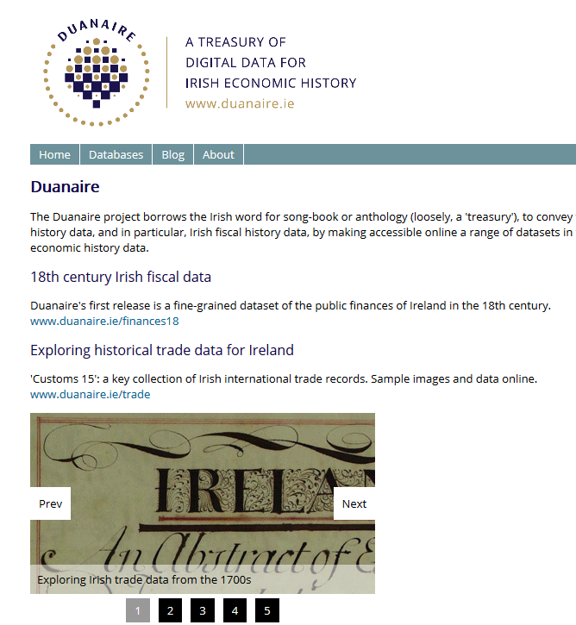
New Digital Project Support Requests

Slide 13
Joining Up: a moment of truth
Strategy
People
Projects
Governance
Technology

Slide 14
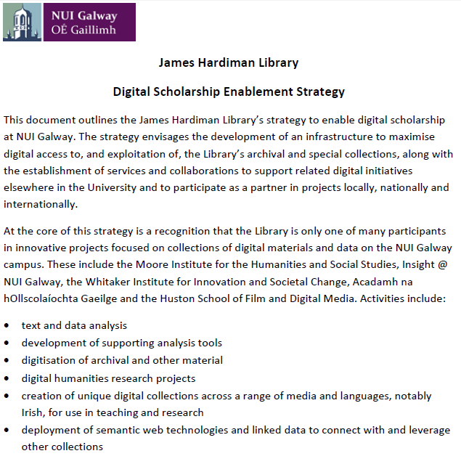
2014: Digital Scholarship Strategy

Slide 15
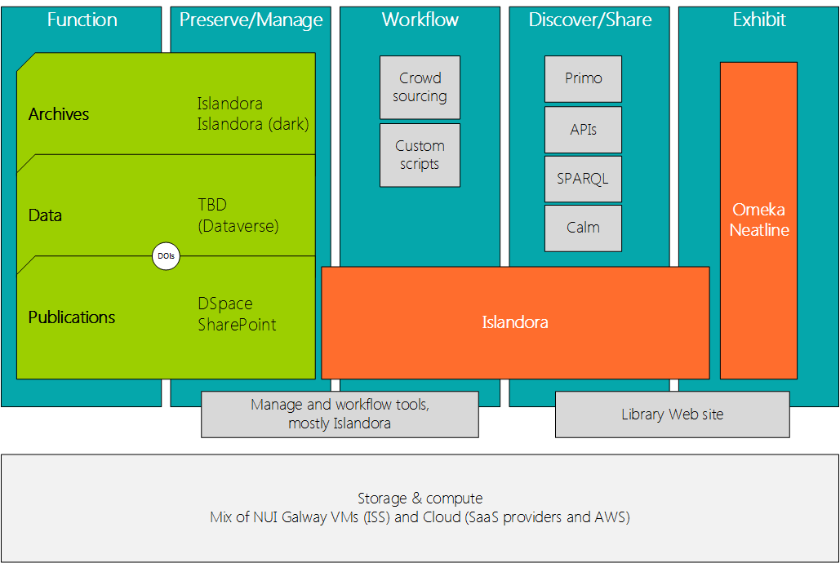
Coverage
Context
Goals
Technology
Standards
Metadata
Discovery
Preservation
Rights Management
Governance and Delivery Structures
Finance
http://tinyurl.com/h4gddj5

Slide 16
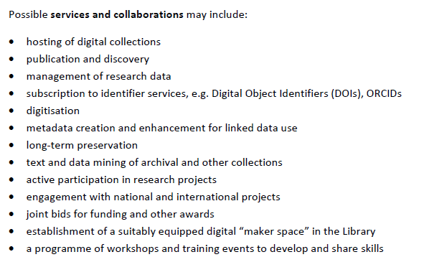
Digital Scholarship: possibilities…

Slide 17
Digital Publishing and Innovation Team
University Librarian
Head of Digital Publishing and Innovation
1 fte
Digital Library Developer1 fte
Digital Publishing and Data Management Librarian 1 fte
Digital Archivist 1 fte
Systems Assistant 0.5fte
Systems Technologist 0.4 fte
Digitisation Technician1fte

Slide 18
Formation of Digital Publishing and Innovation Team
Mix of skills, backgrounds and perspectives
Library, archives and IT backgrounds
Career experience in the academic and commercial sectors
Varied skills including:
programming
metadata
web publishing
information services
strategy
communications

Slide 19
Governance: Digital Library Group
DPI Team+ 2 members in public-facing roles + University Librarian
Steering and co-ordination role
Development of teamwork, strategy and policies
Prioritising activities and resources
Connectivity on campus and externally
Monthly forum for updating, discussion, provocation, reflection and planning

Slide 20
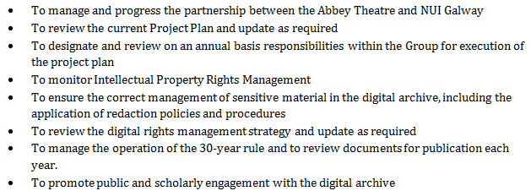
Governance: NUI Galway-Abbey Theatre Project Group

Slide 21
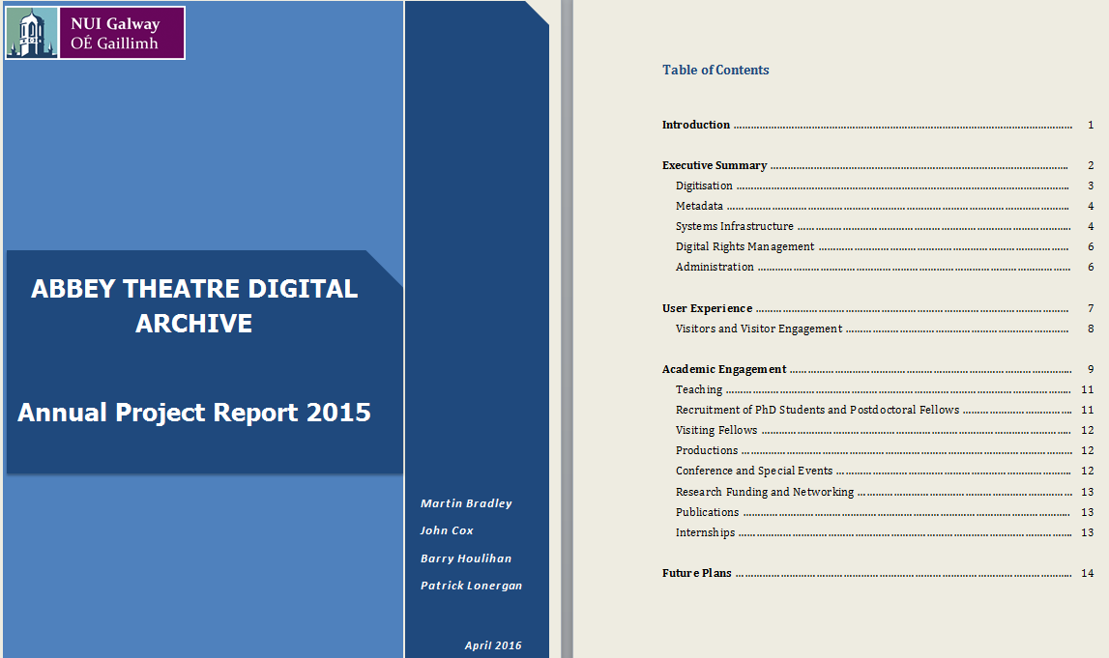
Accountability: annual project reports
http://tinyurl.com/j2sjmsy

Slide 22
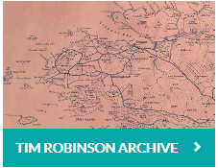
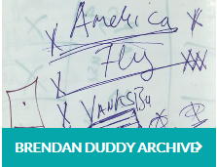
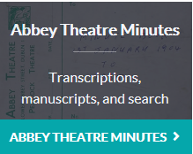
Other Projects and Partnerships: Digital Collections

Slide 23
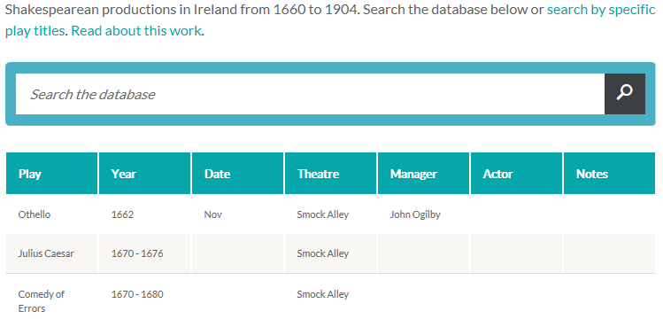
Projects and Partnerships: Databases

Slide 24
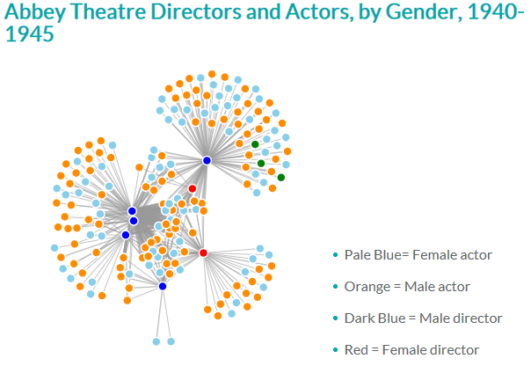
Projects and Partnerships: text and data mining
“NUIG archive is really transforming the way in which we do theatre history research in Ireland”
(Professor Chris Morash, Seamus Heaney Professor of Irish Writing, Trinity College Dublin)

Slide 25
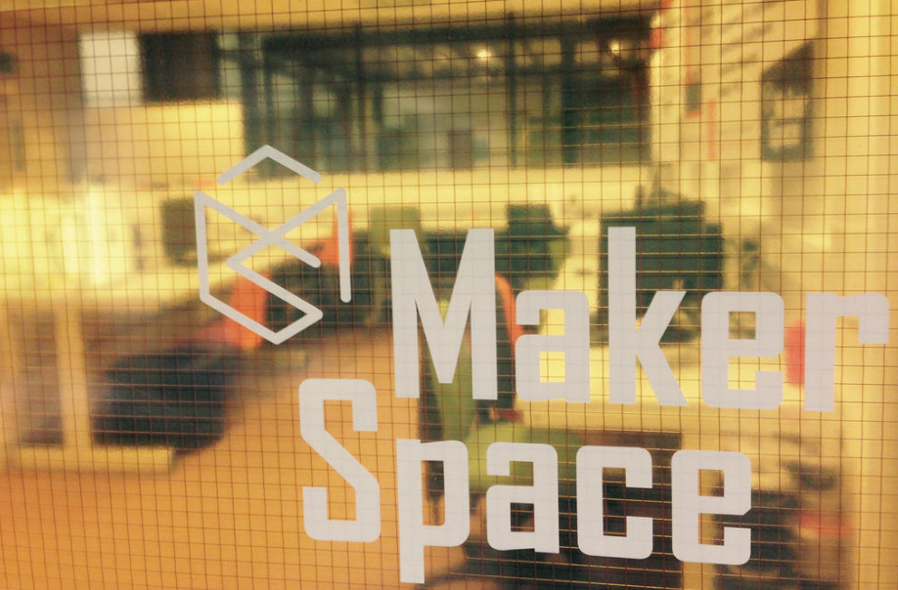
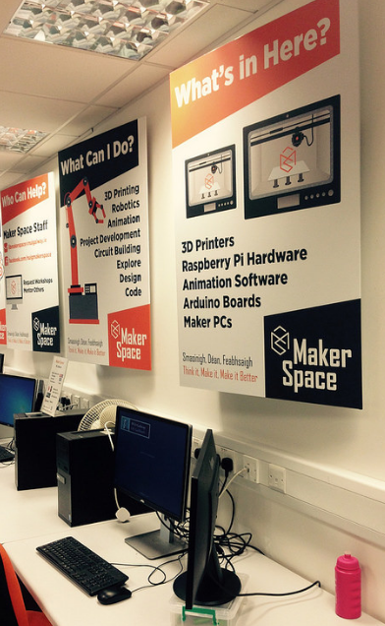
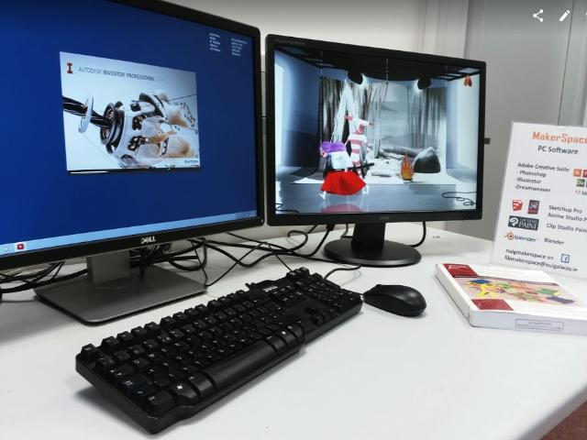
Notes:
We also include our new makerspace under the digital scholarship umbrella
Autodesk Inventor® - Mechanical design and 3D CAD software
Adobe creative suite - Photoshop, Illustrator, Dreamweaver
Sketchup Pro - Easy to learn design software
Anime Studio Pro - Animation software from SmithMicro
Blender - Open source 2 and 3D design software
Clip Studio Paint - Claims it's the standard paint tool for Manga
Cura - This is the software we use to prepare STL files for 3D printing

Slide 26
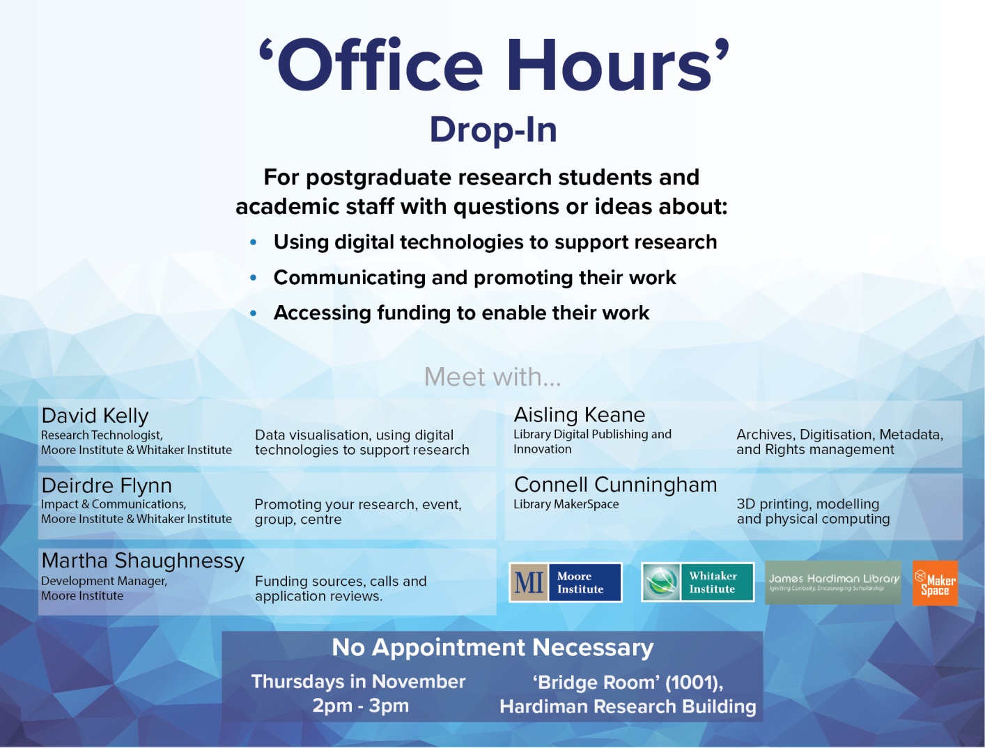
Projects and Partnerships: Digital Scholarship Advice

Slide 27
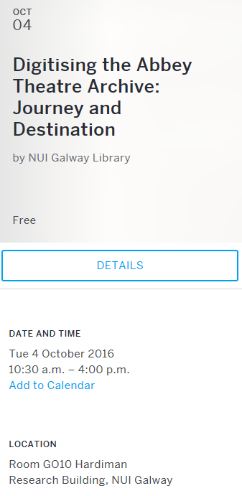
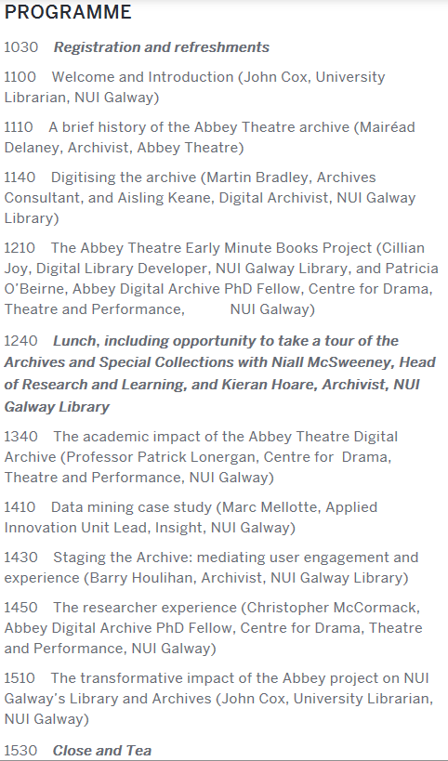
Projects and Partnerships: Seminars
http://tinyurl.com/jl8jgpb

Slide 28
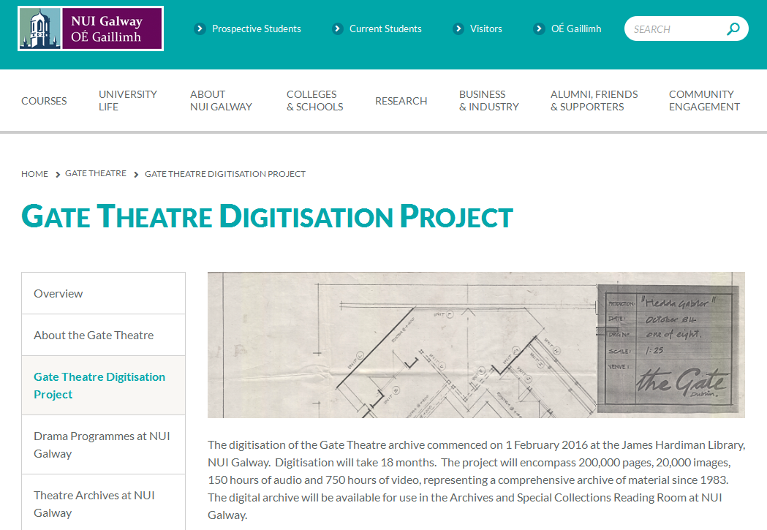
Projects and Partnerships: Large-Scale Digitisation (again…)

Slide 29
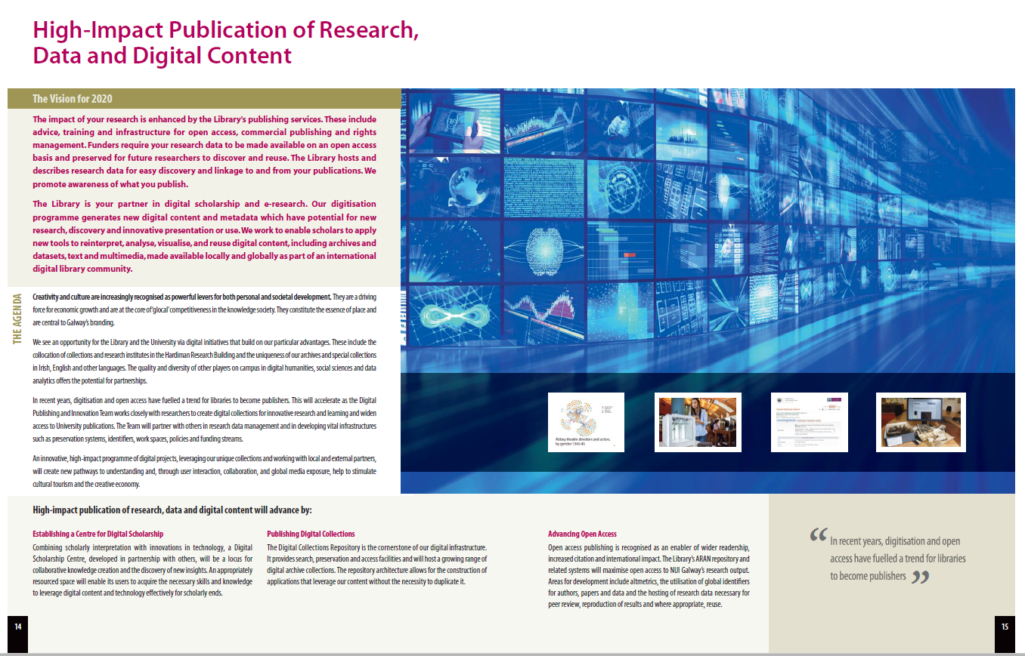
A Library Strategic Priority, 2016

Slide 30
Partnership
More than collaboration
New language
service
support
partner
co-creator

Slide 31
Ongoing Challenges
Funding
Skills
Sustainability
Prioritisation
Estimation
Expectations
Connectivity, internally and externally
Research data: the next frontier

Slide 32
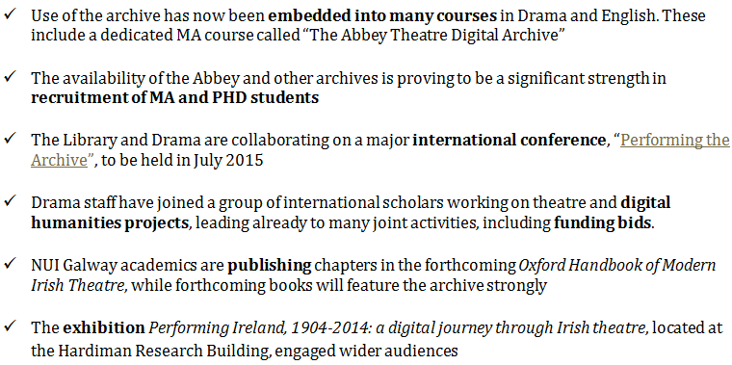
Abbey Theatre Digital Archive@NUI Galway: impact
To date, the combined value of research funding and student scholarships related to the Abbey archive is over €700,000.

Slide 34
Selected References
Cox, J. (2016). Communicating New Library Roles to Enable Digital Scholarship: A Review Article, New Review of Academic Librarianship, 22:2-3, 132-147, http://tinyurl.com/z2k8zst
Abbey project annual reports: http://tinyurl.com/legpsxk
Bradley, M. & Keane, A. (2015). The Abbey Theatre Digitization Project in NUI Galway, New Review of Information Networking, 20:1-2, 35-47, http://dx.doi.org/10.1080/13614576.2015.1114827

